Slide 1







PROJECTS | PRODUCTS | COURSE | INTERNSHIP
info@discoverprojects.com
www.discoverprojects.com
pro.aiskool@gmail.com
www.aiskool.com
Shop no. 2, Narayan Smurti Building, Opp. Saraswati Book Depot,
Near CIDCO Bus Stop, Thane West, India.
+91 9967478289 / +91 9167769993

Slide 2


EMPLOYEE ABSENTEEISM TRACKER
Relevant Image

Slide 3
Introduction and Application
The objective is to build a prediction engine for analysis of employee absenteeism using k nearest neighbour.

Slide 4
Working
FIRST STEP WAS TO COLLECT DATA FROM DIFFERENT SOURCES FOR OUR PROBLEM STATEMENT .
THEN WE HAVE TO CLEAN , PROCESS CATEGORICAL DATA AND NORMALISE IT.
THEN WE SHOW VARIOUS ANALYSIS USING GRAPHS.
SPLIT THE DATA INTO TRAINING AND TEST SET.
SELECT AN ALGORITHM.
FITTING THE MODEL TO TRAINING SET.
SAVING THE MODEL
CHECK ACCURACY OF TRAINED DATA W.R.T TRAIN SET.
TEST THE TRAINED MODEL W.R.T TESTING SET.
CHECK ACCURACY OF TEST DATA W.R.T TEST SET.
BASED ON THE GENERATED GRAPHS WE CAN ANALYSE EMPLOYEES’ ABSENTEEISM.

Slide 5
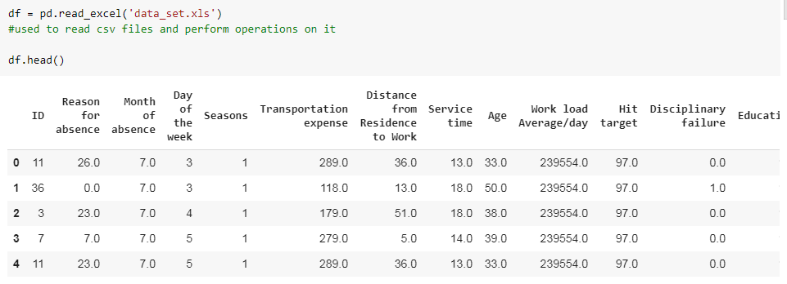
Working and Building
This is the data that we are using for the analysis of employees’ absenteeism. The source of dataset is Kaggle. We have used the read_csv() function of pandas to read the .csv file for dataset and head() function to display the first five lines of dataset.

Slide 6
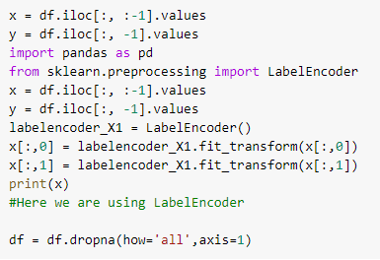
Handling Categorical Data
Label encoding is simply converting each value in a column to a number.

Slide 7
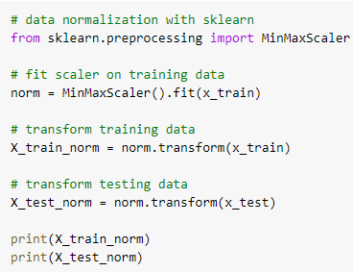
Normalise Data
MinMaxScaler transforms features by scaling each feature to a given range.
fit(self, X[, y]):
Compute the minimum and maximum to be used for later scaling.
transform(self, X):
Scale features of X according to feature_range.

Slide 8
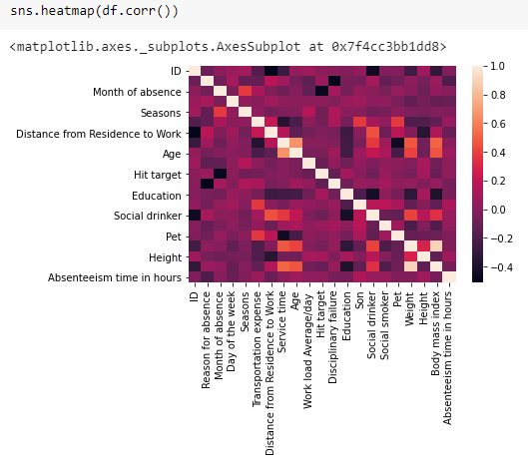
Graphs
A heat map is a data visualization technique that shows magnitude of a phenomenon as color in two dimensions. The variation in color may be by hue or intensity, giving obvious visual cues to the reader about how the phenomenon is clustered or varies over space.

Slide 9
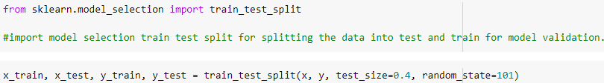
Splitting Data
Python has a library sklearn which contains a function ‘train_test_split’. This function is used to Split arrays or matrices into random train and test subsets.
test_size float or int, default=None:
If float, should be between 0.0 and 1.0 and represent the proportion of the dataset to include in the test split. If int, represents the absolute number of test samples. If None, the value is set to the complement of the train size. If train_size is also None, it will be set to 0.25.
random_state int or RandomState instance, default=None
Controls the shuffling applied to the data before applying the split. Pass an int for reproducible output across multiple function calls.

Slide 10
Selecting Algorithm
The algorithm that we have used is k nearest neighbour.
K nearest neighbors is a simple algorithm that stores all available cases and classifies new cases based on a similarity measure (e.g., distance functions). KNN is a non-parametric, lazy learning algorithm. Its purpose is to use a database in which the data points are separated into several classes to predict the classification of a new sample point. Usually, the Euclidean distance is used as the distance metric. Then, it assigns the point to the class among its k nearest neighbours (where k is an integer).

Slide 11

Fitting the model to trained dataset
We have used the fit() function to fit our model to the training dataset and hence passed the parameters for the same.

Slide 12
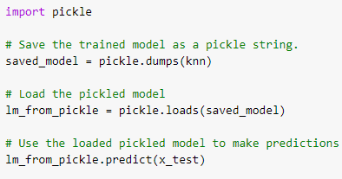
Saving the model
We can use the Pickle library in Python to save our model. In this code we can see that the model has been saved as a string.
So, first we save the model as a string, then we load it and use it to make predictions.

Slide 13
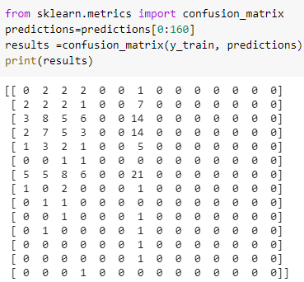
Confusion Matrix
Confusion Matrix function is present in the sklearn library of Python. A confusion matrix is a table that is often used to describe the performance of a classification model (or “classifier”) on a set of test data for which the true values are known. It allows the visualization of the performance of an algorithm.

Slide 14

Precision, Recall, Support, Fscore
The precision is intuitively the ability of the classifier not to label as positive a sample that is negative. The recall is intuitively the ability of the classifier to find all the positive samples.The F-beta score can be interpreted as a weighted harmonic mean of the precision and recall, where an F-beta score reaches its best value at 1 and worst score at 0.The support is the number of occurrences of each class in y_true. We have used the precision_recall_fscore_support() function for the same.
**In the same way we will calculate the confusion matrix, precision, recall, support and fscore for the test dataset.**

Slide 15
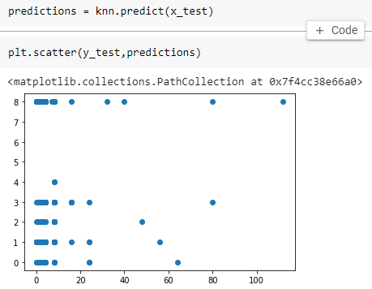
Prediction
We have used the predict() function for making the predictions on our model. Also. scatter() method is used to plot the graph for our predictions.

Slide 16
Evaluate, Tune and Improve Neural Network
In this code we have used the MSE, MAE and RMSE method for evaluation.
Mean Absolute Error: We know that an error basically is the absolute difference between the actual or true values and the values that are predicted.
Mean Square Error: MSE is calculated by taking the average of the square of the difference between the original and predicted values of the data.
Root Mean Square Error: RMSE is the standard deviation of the errors which occur when a prediction is made on a dataset. This is the same as MSE (Mean Squared Error) but the root of the value is considered while determining the accuracy of the model.

Slide 17
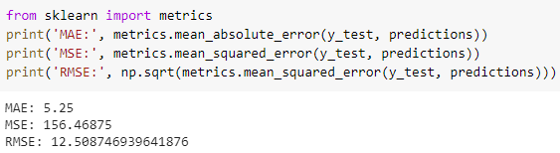
Calculating Efficiency:
We have used the mean_absolute_error(), mean_squared_error() and square root of mean_squared_error() functions of metrics from sklearn library of Python to calculate the MAE, MSE and RMSE values.

Slide 18
FAQ
What is the use of read_csv()?
read_csv() is an important pandas function to read csv files and do operations on it.
2. What is the use of iloc?
iloc returns a Pandas Series when one row is selected, and a Pandas DataFrame when multiple rows are selected, or if any column in full is selected. To counter this, pass a single-valued list if you require DataFrame output.
3. Why should we not use KNN algorithm for large datasets?
KNN works well with smaller dataset because it is a lazy learner. It needs to store all the data and then makes decision only at run time. So if dataset is large, there will be a lot of processing which may adversely impact the performance of the algorithm.

Slide 19
FAQ
4. What is the difference between the RMSE and RMSLE method for measuring accuracy?
The value of the RMSE explodes in magnitude as soon as it encounters an outlier. In contrast, even on the introduction of the outlier, the RMSLE error is not affected much i.e. RMSLE is very robust when outliers come into play.
5. Can we use RMSLE method for measuring accuracy?
Yes, we can.

